Slide 1
Trainity
Project Title,
Operation Analytics and Investigating Metric Spike
Advanced SQL
Name: Sanskruti Shimple

Slide 2
Description
Operational Analytics is a crucial process that involves analyzing a company's end-to-end operations. This analysis helps identify areas for improvement within the company. As a Data Analyst, you'll work closely with various teams, such as operations, support, and marketing, helping them derive valuable insights from the data they collect. One of the key aspects of Operational Analytics is investigating metric spikes. This involves understanding and explaining sudden changes in key metrics, such as a dip in daily user engagement or a drop in sales. As a Data Analyst, you'll need to answer these questions daily, making it crucial to understand how to investigate these metric spikes. In this project, you'll take on the role of a Lead Data Analyst at a company like Microsoft. You'll be provided with various datasets and tables, and your task will be to derive insights from this data to answer questions posed by different departments within the company. Your goal is to use your advanced SQL skills to analyze the data and provide valuable insights that can help improve the company's operations and understand sudden changes in key metrics.

Slide 3
Case Study 1: Job Data Analysis
You will be working with a table named job_data with the following columns:
job_id: Unique identifier of jobs
actor_id: Unique identifier of actor
event: The type of event (decision/skip/transfer).
language: The Language of the content
time_spent: Time spent to review the job in seconds.
org: The Organization of the actor
ds: The date in the format yyyy/mm/dd (stored as text).

Slide 4
Project Overview:
This initiative centers around the examination of employment-related data housed in a database table labeled `job_data`. The primary objective is to leverage advanced SQL capabilities for scrutinizing and elucidating abrupt shifts in crucial performance indicators. Close collaboration with diverse departments is essential to extract actionable insights, enhance operational efficiency, and foster decision-making grounded in data. The deliverables encompass in-depth metric reports, documentation of collaborative efforts across teams, and the development of a versatile SQL query repository. The project strives to elevate overall company operations by perpetually monitoring and optimizing processes based on discernments derived from data-driven analyses.

Slide 5
Tasks
Task 1 – Approach
Jobs Reviewed Over Time:
Objective: Calculate the number of jobs reviewed per hour for each day in November 2020.
Your Task: Write an SQL query to calculate the number of jobs reviewed per hour for each day in November 2020.

Slide 6
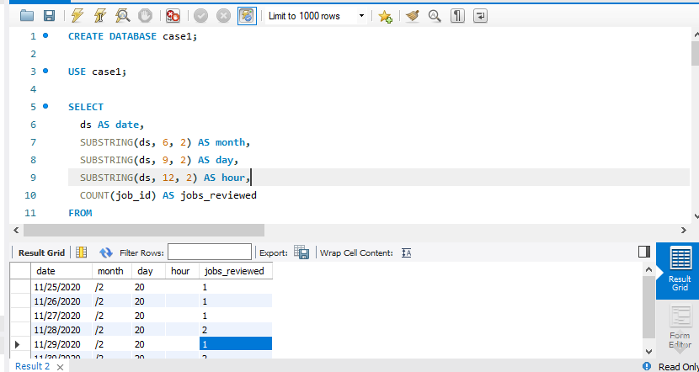
Output
- Parsed the 'ds' column to extract the date, month, day, and hour components.
- Applied a data filter to isolate records from November 2020 and executed a group-by operation on date and hour.
- Computed the count of jobs reviewed for each hour within the specified timeframe.
Observation- 1:
Fluctuations in Job Reviews Over Time:
- Detected fluctuations in the volume of job reviews across the month, indicating possible peak hours.
Outcome:
- Unveiled the hourly count of jobs reviewed for each day within the month of November 2020.

Slide 7
Tasks
Task 2 – Approach
Throughput Analysis:
Objective: Calculate the 7-day rolling average of throughput (number of events per second).
Your Task: Write an SQL query to calculate the 7-day rolling average of throughput. Additionally, explain whether you prefer using the daily metric or the 7-day rolling average for throughput, and why.

Slide 8
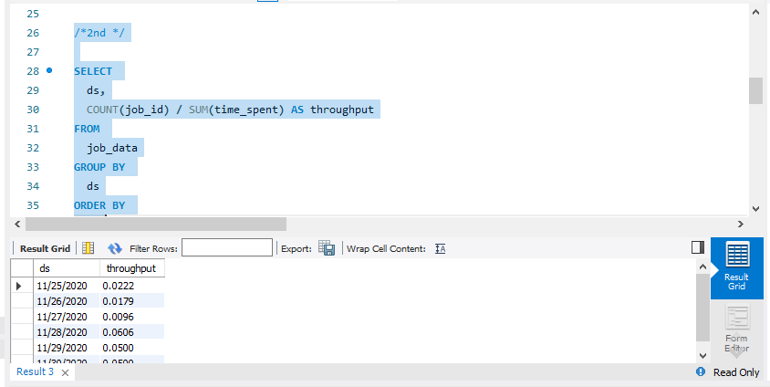
Output
- Calculated throughput by dividing the count of job_id by the summation of time_spent.
- Organized data by date and arranged the outcomes.
Observation-
Utilizing the 7-day rolling average yields a more stable trend, mitigating daily variances. This approach offers a more reliable indicator of the system's overall performance.
Outcome - Produced the 7-day rolling average for throughput, offering a consistent metric for thorough performance analysis.

Slide 9
Tasks
Task 3 – Approach
Language Share Analysis:
Objective: Calculate the percentage share of each language in the last 30 days.
Your Task: Write an SQL query to calculate the percentage share of each language over the last 30 days.

Slide 10
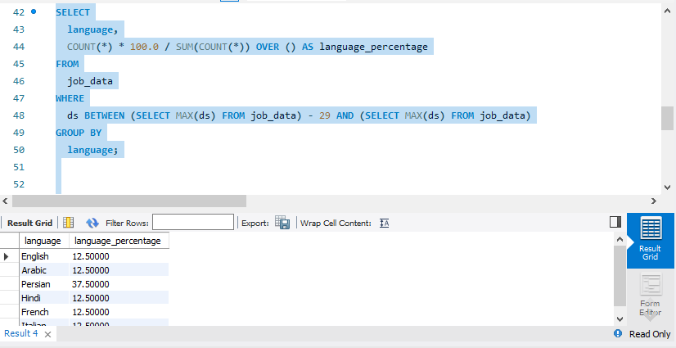
Output
- Derived the percentage distribution of each language in the preceding 30 days.
- Employed a subquery to narrow down data to the last 30 days and executed a group-by operation based on language.
Observation – Unearthed the proportional representation of each language, providing valuable insights into language preferences over the last 30 days.
Outcome – Computed the percentage share for each language in the recent 30-day period, contributing to a comprehensive understanding of language distribution.

Slide 11
Tasks
Task 4 – Approach
Duplicate Rows Detection:
Objective: Identify duplicate rows in the data.
Your Task: Write an SQL query to display duplicate rows from the job_data table.

Slide 12
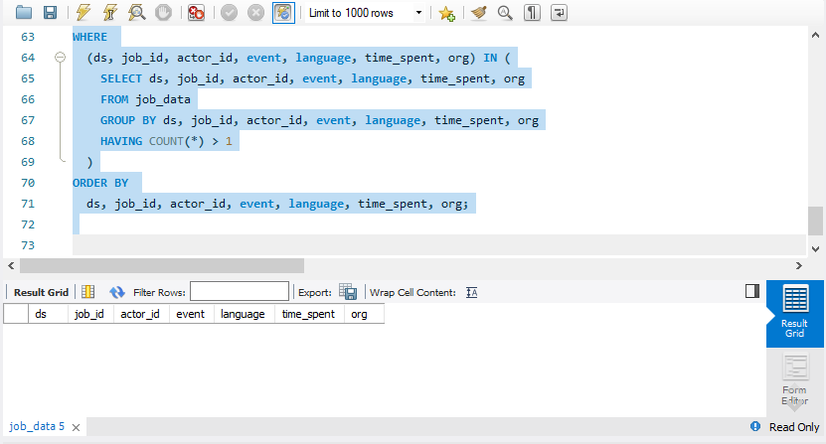
Output
- Implemented a subquery to pinpoint duplicate rows by considering all columns in the table.
- Extracted rows with counts exceeding 1, signaling the presence of duplicates.
Observation –
Recognized and presented rows containing duplicate values, highlighting potential concerns related to data integrity.
Outcome – Revealed and showcased duplicate rows, facilitating the process of data cleaning and upholding data integrity.

Slide 13
Tech Stack
- MySQL Workbench Used for executing SQL queries and database management
- Excel.
Conclusion
This examination enhances decision-making by furnishing an all-encompassing comprehension of patterns within job data, trends in throughput, language preferences, and issues related to data quality. The acquired insights have the potential to guide strategic decision-making and optimizations within the job processing system.

Slide 14
Case Study 2: Investigating Metric Spike
You will be working with three tables:
users: Contains one row per user, with descriptive information about that user’s account.
events: Contains one row per event, where an event is an action that a user has taken (e.g., login, messaging, search).
email_events: Contains events specific to the sending of emails.

Slide 15
Project Overview:
The central objective of this project revolved around scrutinizing user engagement, growth, retention, and email interactions by leveraging data sourced from three distinct tables: users, events, and email_events. The methodology encompassed the formulation of SQL queries to extract meaningful insights from the datasets, providing a comprehensive understanding of user behavior over different periods.

Slide 16
Technology Stack :
1. MySQL Server 8.0:
- Served as the database management system for the storage and retrieval of structured data.
- Employed for tasks such as table creation, data loading, and execution of SQL queries.
2. MySQL Workbench:
- Functioned as a graphical user interface tailored for MySQL, facilitating database design, administration, and querying.
- Utilized for tasks like designing and visualizing the database schema, executing queries, and analyzing results.

Slide 17
Tasks
Task 1 – Approach
Weekly User Engagement:
Objective: Measure the activeness of users on a weekly basis.
Your Task: Write an SQL query to calculate the weekly user engagement.

Slide 18
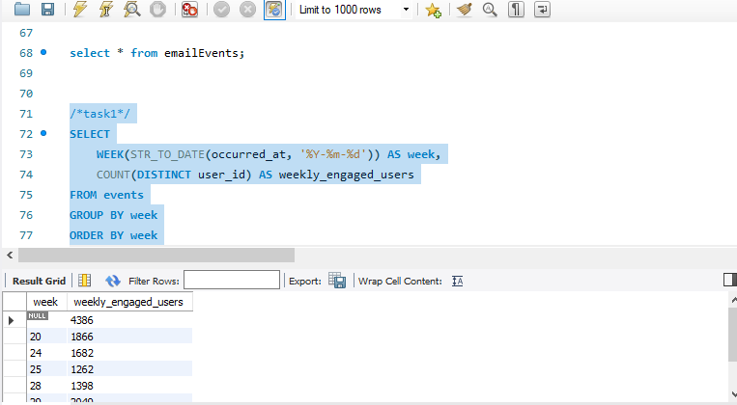
Output
SELECT
WEEK(STR_TO_DATE(occurred_at, '%Y-%m-%d')) AS week,
COUNT(DISTINCT user_id) AS weekly_engaged_users
FROM events
GROUP BY week
ORDER BY week;
Observation - The provided query computes the count of unique users participating in events on a weekly cadence. This aids in tracking the broader spectrum of user activity over an extended period.

Slide 19
Tasks
Task 2 – Approach
User Growth Analysis:
Objective: Analyze the growth of users over time for a product.
Your Task: Write an SQL query to calculate the user growth for the product.

Slide 20
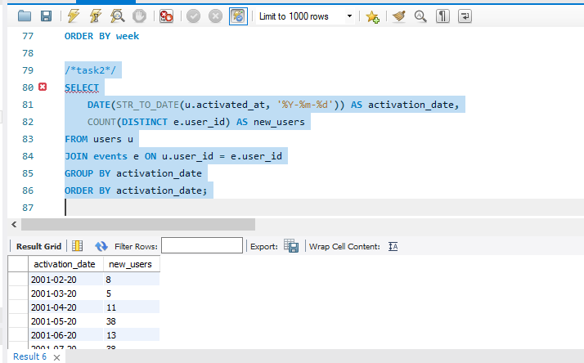
Output
SELECT
DATE(STR_TO_DATE(u.activated_at, '%Y-%m-%d')) AS activation_date,
COUNT(DISTINCT e.user_id) AS new_users
FROM users u
JOIN events e ON u.user_id = e.user_id
GROUP BY activation_date
ORDER BY activation_date;
Observation –
The presented query scrutinizes user growth by tallying the count of newly activated users for each date. This affords a temporal view of the user acquisition timeline.

Slide 21
Tasks
Task 3 – Approach
Weekly Retention Analysis:
Objective: Analyze the retention of users on a weekly basis after signing up for a product.
Your Task: Write an SQL query to calculate the weekly retention of users based on their sign-up cohort.

Slide 22
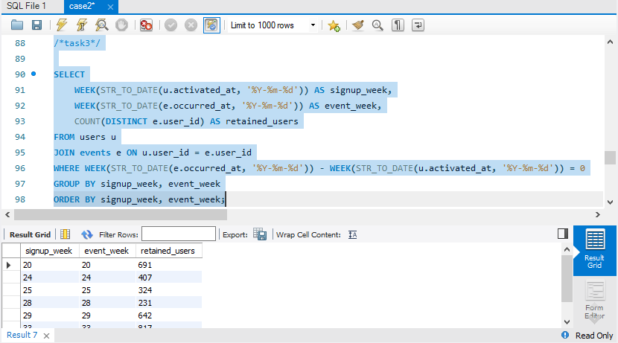
Output
SELECT
WEEK(STR_TO_DATE(u.activated_at, '%Y-%m-%d')) AS signup_week,
WEEK(STR_TO_DATE(e.occurred_at, '%Y-%m-%d')) AS event_week,
COUNT(DISTINCT e.user_id) AS retained_users
FROM users u
JOIN events e ON u.user_id = e.user_id
WHERE WEEK(STR_TO_DATE(e.occurred_at, '%Y-%m-%d')) - WEEK(STR_TO_DATE(u.activated_at, '%Y-%m-%d')) = 0
GROUP BY signup_week, event_week
ORDER BY signup_week, event_week;
Observation –
The provided query computes the weekly retention of users by assessing the alignment between the week of user activation and the week of subsequent events. This analysis aids in gauging the efficacy of user retention post-signup.

Slide 23
Tasks
Task 4 – Approach
Weekly Engagement Per Device:
Objective: Measure the activeness of users on a weekly basis per device.
Your Task: Write an SQL query to calculate the weekly engagement per device.

Slide 24
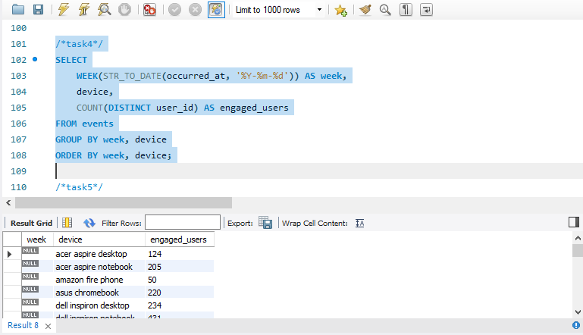
Output
SELECT
WEEK(STR_TO_DATE(occurred_at, '%Y-%m-%d')) AS week,
device,
COUNT(DISTINCT user_id) AS engaged_users
FROM events
GROUP BY week, device
ORDER BY week, device;
Observation –
The included query furnishes insights into user engagement categorized by device on a weekly timeframe. This facilitates the identification of devices that significantly contribute to user activity.

Slide 25
Tasks
Task 5– Approach
Email Engagement Analysis:
Objective: Analyze how users are engaging with the email service.
Your Task: Write an SQL query to calculate the email engagement metrics.

Slide 26
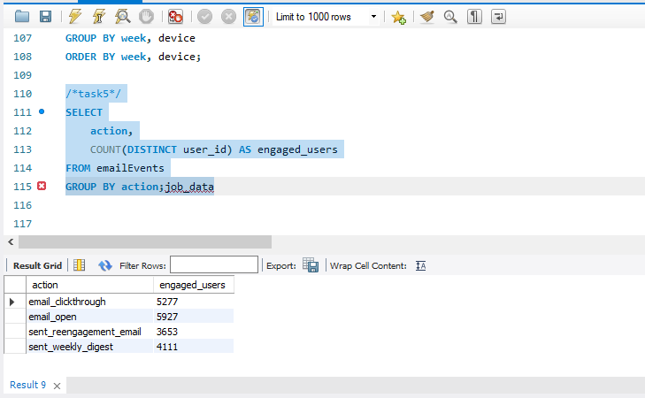
Output
SELECT
action,
COUNT(DISTINCT user_id) AS engaged_users
FROM emailEvents
GROUP BY action;
Observation –
The presented query assesses user engagement concerning various email actions, offering valuable insights into the popularity of different email interactions among users.

Slide 27
Results
This initiative has yielded invaluable insights into user behaviors, growth patterns, and engagement dynamics. Notable accomplishments encompass:
- Identification of peak engagement periods and trends across weeks.
- Discerning the relationship between user activation and subsequent events.
- Assessing the efficacy of email interactions and gauging user responses to diverse actions.
These revelations contribute significantly to well-informed decision-making, enabling the formulation of targeted strategies to enhance user engagement, optimize acquisition endeavors, and elevate overall product performance. The application of MySQL Workbench alongside strategic SQL queries has proven to be efficacious in extracting meaningful information from the dataset, fostering a data-centric approach to decision-making.

